Slide 1
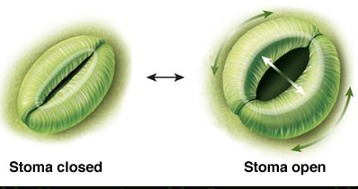
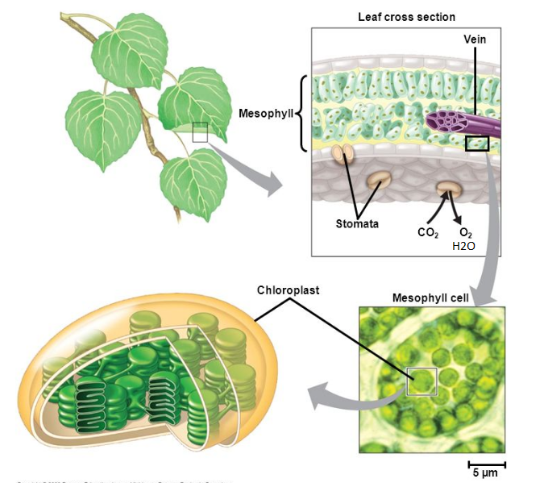
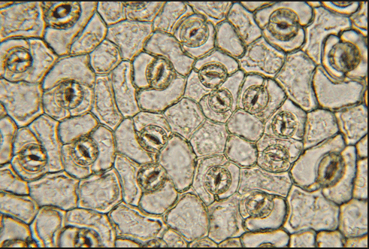
The ever-evolving suite of approaches for modeling stomatal conductance
K. Novick, Flux Course 10, July 11, 2017
Stomatal conductance (g_{s}) describes the “openness” of plant stoma
CO₂ travels through the stomates and the mesophyll before reaching chloroplasts in mesophyll cells.

Slide 2
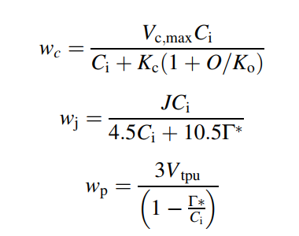

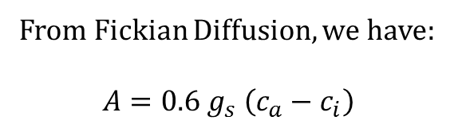
Understanding and modeling the functioning of stomates has been an active research topic for decades. Why?
It’s necessary to provide closure for the Farquhar model
The Farquhar Model (as expressed by Long & Bernacchi 2003):
From Fickian Diffusion, we have:
$$A=0.6{ g}_{s} \left(c_{a}−c_{i}\right)$$
A_{c}
Two equations, three unknowns (A, C_{i}, g_{s})
If g_{s} is modeled or measured, we have closure.
A_{p}
Pop quiz: How do we measure g_{s} using a LI-6400?
A_{J}
One equation, two unknowns (A, C_{i})
Answer: From Transpiration
$${Transpiration= T}_{r}=g_{s}\left(e_{a}−e_{leaf}\right)≈g_{s}VPD$$
e_{a} = vapor pressure in air
e_{i} = vapor pressure in the leaf

Slide 3
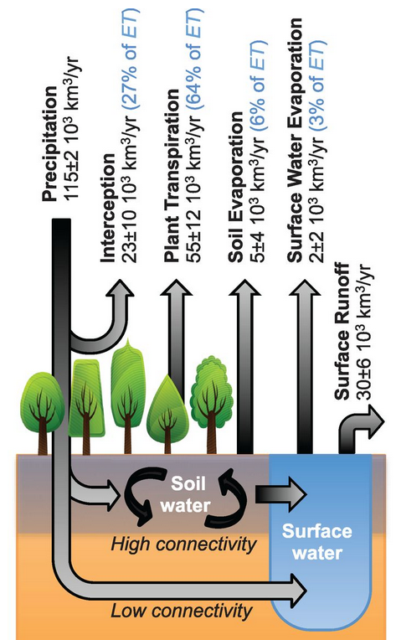
Understanding and modeling the functioning of stomates has been an active research topic for decades. Why?
Stomatal conductance drives tranpsiration– a key hydrologic cycle flux
Evapotranspiration is a cooling process – how plants use water can exert strong control on local temperature
From Good et al. Science, 2015

Slide 4
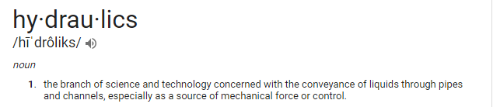
Discussion Topic: What factors determine stomatal conductance? Think about meteorological and biological factors, and drivers that can change rapidly or slowly.
Meteorological:
Soil moisture
Vapor pressure deficit (VPD)
Temperature
Light
CO₂
Stomates close when water is limiting
Stomatal functioning is linked to photosynthesis
Structure/Physiological:
LAI (determines canopy-level G_{s})
Canopy height (g_{s} decreases with h)
Xylem Conductivity (K)
Xylem vulnerability to cavitation
Plant hydraulics

Slide 5
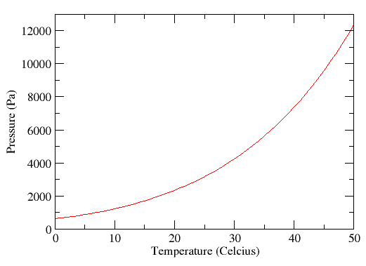
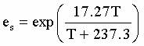
What is Vapor Pressure Deficit?
(Usually represented as VPD or D)
Think of it as how much room there is in the atmosphere for more water vapor
When RH = 100%, VPD = 0 kPa. As humidity declines, VPD increases.
It is the difference between the saturation vapor pressure (e_{s} ) and the actual vapor pressure deficit (e_{a}). VPD = e_{s} – e_{a}.
The saturation vapor pressure is exponentially related to temperature.

Slide 6
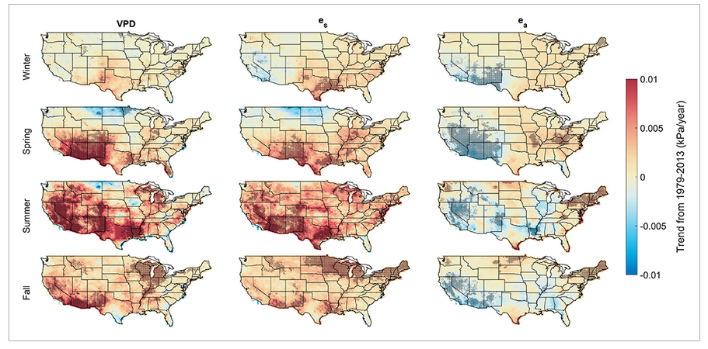
Historically, It’s been rising in many places, especially during the summer…
Ficklin & Novick 2017

Slide 7
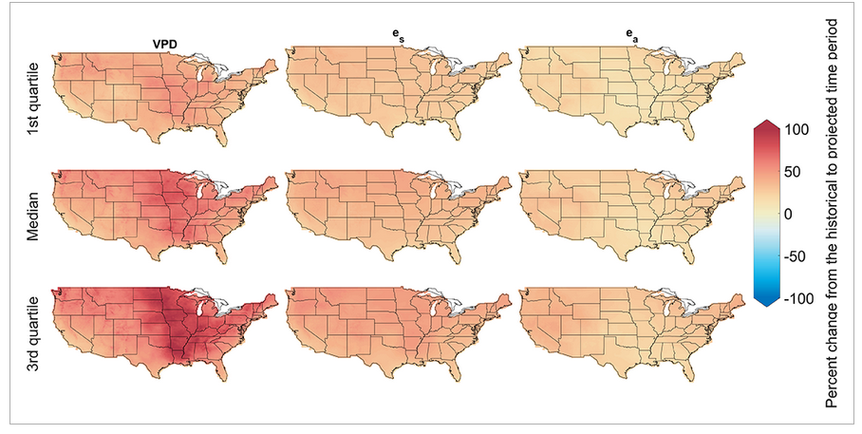
And is projected to rise nearly universally in the future
Comparing historic (1979-2013) to future (2065-2099) VPD, Ficklin & Novick 2017

Slide 8


Some widely used models for g_{s}
Ball-Berry Model (see Collatz et al. 1991):
$$g_{s}=m\frac{A∙RH}{c_{s}}+b$$
c_{s} is CO₂ concentration at the leaf surface, c_{s} ~ c_{a} if leaf boundary layer conductance is high
Leuning model (Leuning, 1995)
$$g_{s}=\frac{m_{2}A}{c_{s}−Γ}{\left(1+\frac{D}{D_{o}}\right)}^{−1}+b_{2}$$
Γ is the CO₂ compensation point. M₂, D_{o}, and b_{s} are constants
What’s missing from these models?
Hydraulics
Soil moisture (comes in empirically through a parameter that can reduce A)
Also, RH/VPD sensitivity is highly empirical

Slide 9
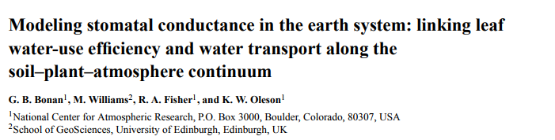
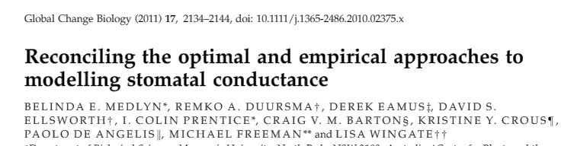
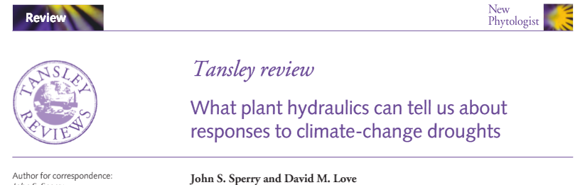
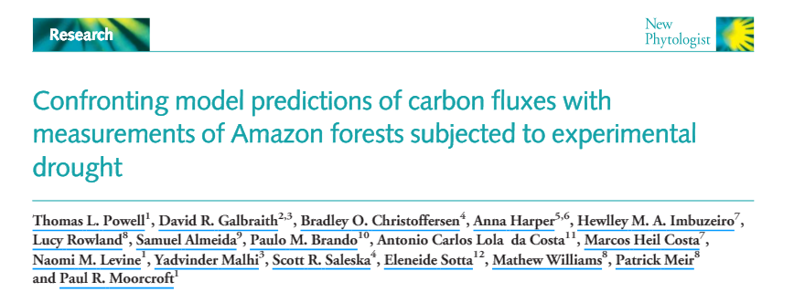
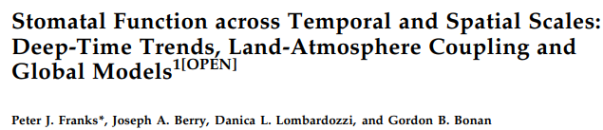
The evidence is mounting that Ball-Berry and Leuning Type models do not perform particularly well during drought conditions. Their theoretical basis is also questioned.
The performance of the SPA stomatal model was … significantly better than the CLM Ball–Berry model when there was soil moisture stress.
[B]ecause these stomatal conductance models are empirical, their parameters have no meaning attached….acclimation and adaptation
Empirical functions … lack the predictive power of a physically constrained equation... As a result, capturing the drought response has proven difficult for ecosystem models.
Model predictions agreed with the observed C fluxes in the control plots of both experiments, but poorly replicated the responses to the drought treatments.
Less is known about how to represent stomatal closure in dry soils…there is considerable ongoing model development to implement … the effects of plant hydraulic stress on stomata

Slide 10
Two active paths towards next generation models for stomatal conductance:
Plant Hydraulics
Stomatal Optimization Theory

Slide 11
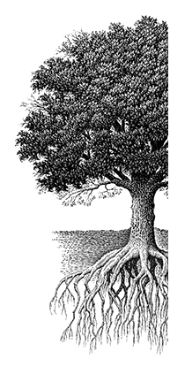
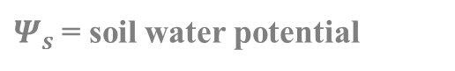
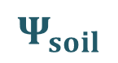
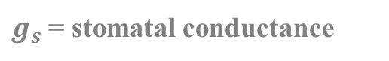
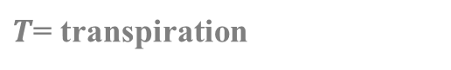
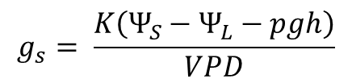
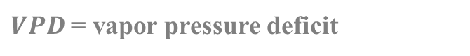
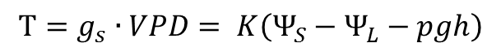
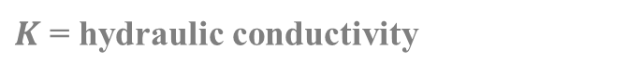

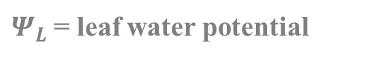
A Plant Hydraulics View of stomatal function
An Ohm’s law analogy for plant water flow through a plant
$$T=g_{s}∙VPD= K\left(Ψ_{S}−Ψ_{L}−pgh\right)$$
$$Ψ_{leaf}$$
$$g_{s}= \frac{K\left(Ψ_{S}−Ψ_{L}−pgh\right)}{VPD}$$
$T$= transpiration
Stomatal conductance depends on both soil water status and VPD!
$g_{s}$= stomatal conductance
h
$Ψ_{s}$= soil water potential
$Ψ_{L}$= leaf water potential
$K$ = hydraulic conductivity
$$Ψ_{soil}$$
$VPD$= vapor pressure deficit

Slide 12
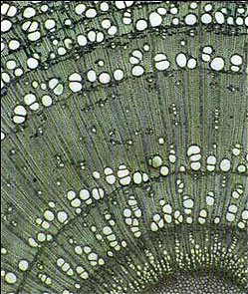

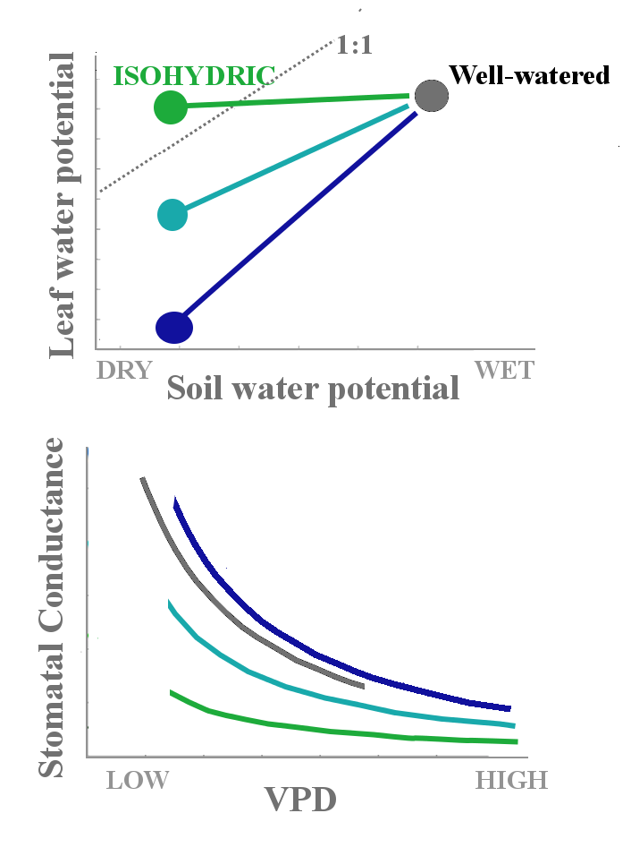
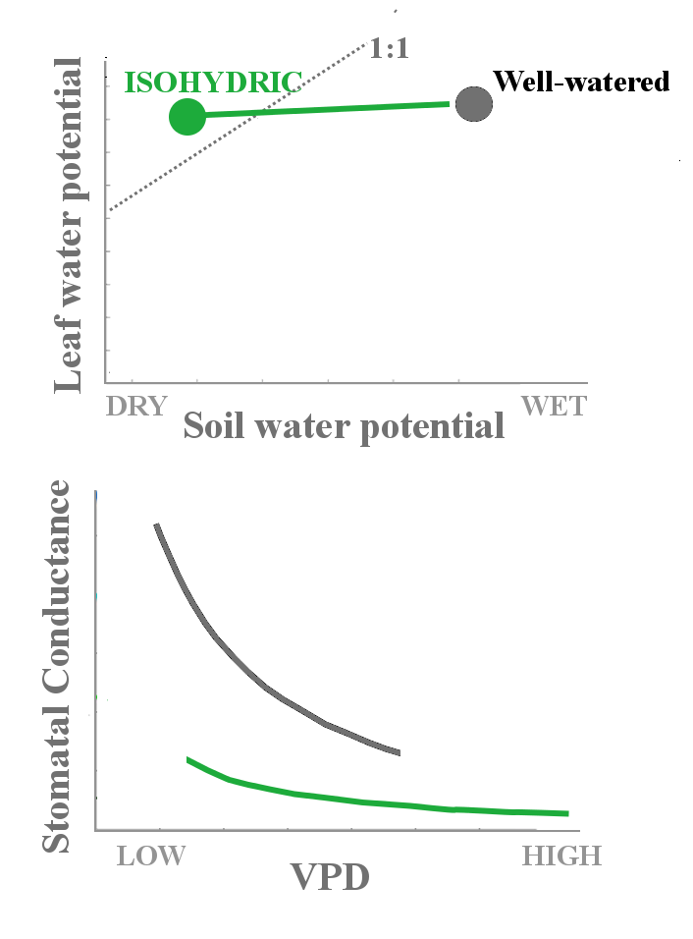
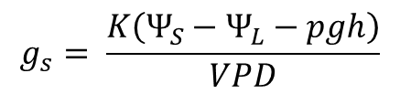
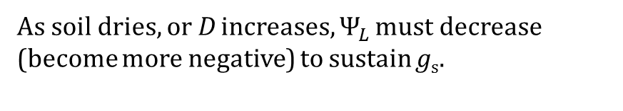
As soil dries, or D increases, $Ψ_{L }$must decrease (become more negative) to sustain g_{s}.
$$g_{s}= \frac{K\left(Ψ_{S}−Ψ_{L}−pgh\right)}{VPD}$$
This is a dangerous operation for the tree!
http://nhm.ac.uk/resources-rx/images
Isohydric trees maintain relatively constant leaf water potential…conductance declines rapidly
Anisohydric trees allow leaf water potential to fall…incurring risk of cavitation

Slide 13
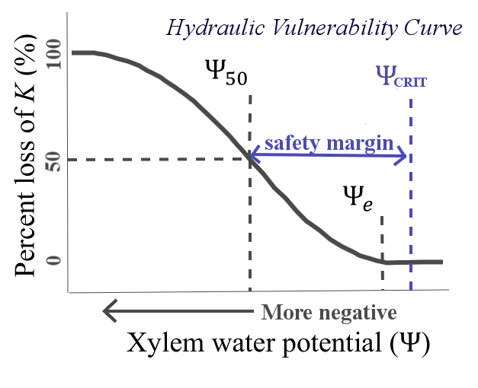
Generally believed that degree of isohydricity is linked to xylem vulnerability

Slide 14
Generally, it is believed that plants with more vulnerable xylem are more isohydric
Consider a prototypical isohydric species (Pinyon pine) and anisohydric species (Juniper) growing in the American Southwest:
Isohydric Pinyon pine is associated with more vulnerable xylem and smaller safety margins when compared to anisohydric Juniper
McDowell et al. (2008), Plaut et al. (2012)
But there is emerging evidence that this is not the case in some wetter climates.

Slide 15
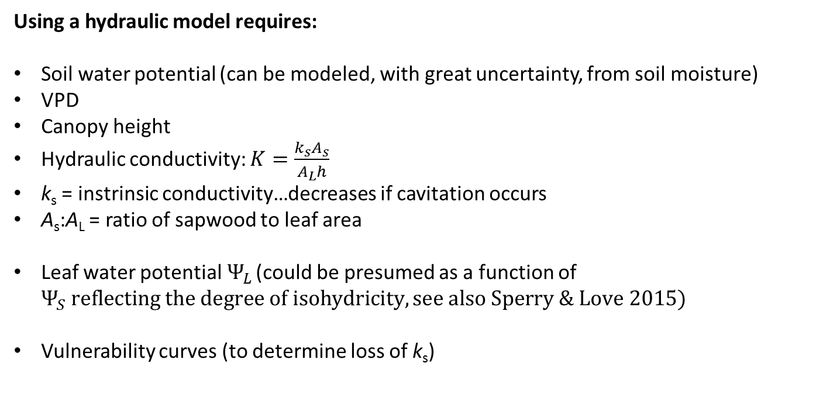
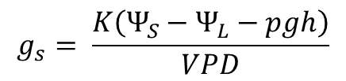
$$g_{s}= \frac{K\left(Ψ_{S}−Ψ_{L}−pgh\right)}{VPD}$$
Using a hydraulic model requires:
Soil water potential (can be modeled, with great uncertainty, from soil moisture)
VPD
Canopy height
Hydraulic conductivity: $K=\frac{k_{s}A_{s}}{A_{L}h}$
k_{s} = instrinsic conductivity…decreases if cavitation occurs
A_{s}:A_{L} = ratio of sapwood to leaf area
Leaf water potential${ Ψ}_{L}$ (could be presumed as a function of $Ψ_{S} reflecting the degree of isohydricity, see also Sperry \& Love 2015)$
Vulnerability curves (to determine loss of k_{s})
What’s missing?
photosynthesis

Slide 16
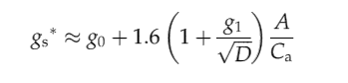
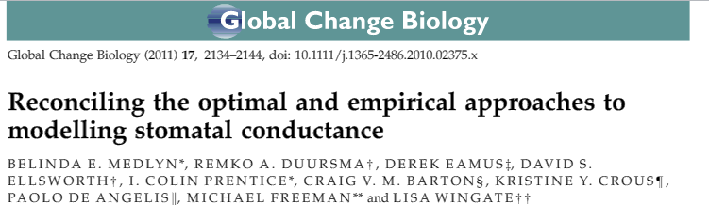
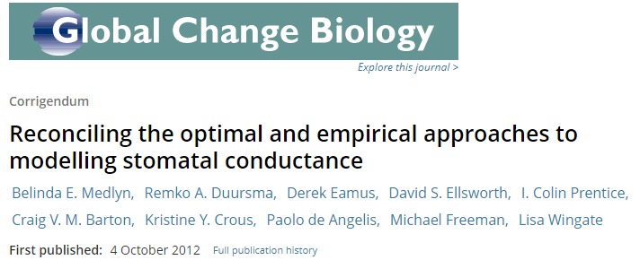



Stomatal optimization models assume that plants have evolved to maximize carbon uptake while minimizing water loss.
Farquhar model for A
Diffusion analogies for A and T_{r}
$$F=A−mWUE{×T}_{r}$$
$$F=f(g_{s})$$
Optimal g_{s} is the g_{s} when dF/dg_{s} = 0.
The approach is not new (Cowan & Farquhar 1977, Cowan 1986, Berninger & Hari 1993, Katul et al. 2009, Medlyn et al. 2011, 2012, Bonan et al. 2014, Sperry et al. 2016, Novick et al. 2016)

Slide 17
The g₁ parameter is sometimes called the ‘marginal water use efficiency.’ It is believe to be constant over the course of a day, but to increase as drought develops
Getting the temporal variability of g₁ right is a key challenge in implementing these models
What’s missing?
Plant hydraulics
Soil moisture dependence is not explicit
Major advancement is that the vapor pressure dependence is theoretical, not empirical

Slide 18
Two paths towards next generation models for stomatal conductance:
How can we bridge the two views?
Plant Hydraulics
Stomatal Optimization Theory
Pros:
Incorporate structural controls on g_{s}
Theoretical approach for modeling soil moisture dependencies
Cons:
No photosynthesis
Getting leaf water potential right is hard
Pros:
Theoretical formulation for VPD dependency
Elegant
Cons:
No hydraulics
Getting g₁ right is hard

Slide 19
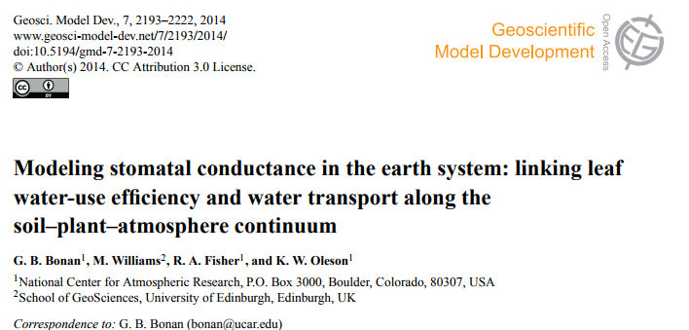
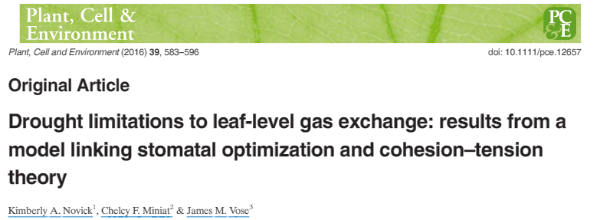
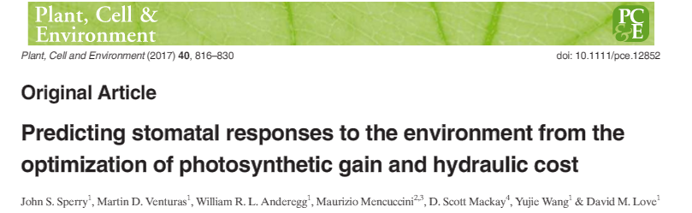
How can we bridge the two views?
Conductance is estimated from optimality but with the constraint that leaf water potential can not dip below some minimum value
The marginal water use efficiency parameter (e.g. g₁) is linked to xylem vulnerability.

Slide 20
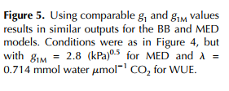
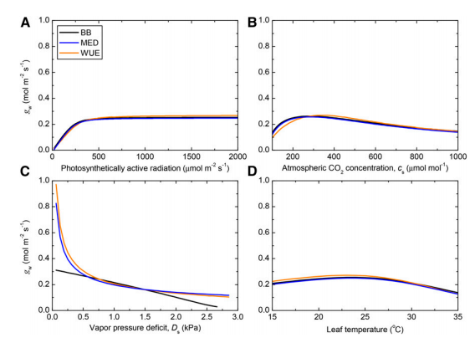
So, I need a model of stomatal conductance for my site…which should I choose?
Depends on the application…don’t choose one that’s ‘missing’ some key driver from the perspective of your research questions.
Franks et al. 2017
Ball-Berry and Leuning models remain good choices while the community is sorting out the details of the next-generation optimality/hydraulics models.
Also, keep in mind that you can derive an estimate of canopy-scale stomatal conductance from flux tower data by inverting the Penman-Monteith Equation (more on that on Friday).

Slide 21

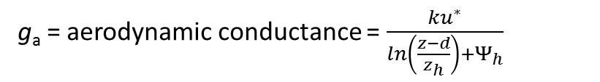
Penman – Monteith (1965): ET from a vegetated surface
$$ET=\frac{Δ(R_{N}−G)+c_{p}ρ_{a}g_{a}D}{λρ_{w}\left[Δ+γ\left(1+\frac{g_{a}}{g_{c}}\right)\right]}$$
g_{a} = aerodynamic conductance = $\frac{ku^{∗}}{ln\left(\frac{z−d}{z_{h}}\right)+Ψ_{h}}$
g_{c} = total surface conductance = incorporates soil and plant conductances
D = vapor pressure deficit
R_{N} – G is the available radiation
Surface conductance is best representative of stomatal conductance when soil evaporation is minimal, and conditions are well mixed.

Slide 22
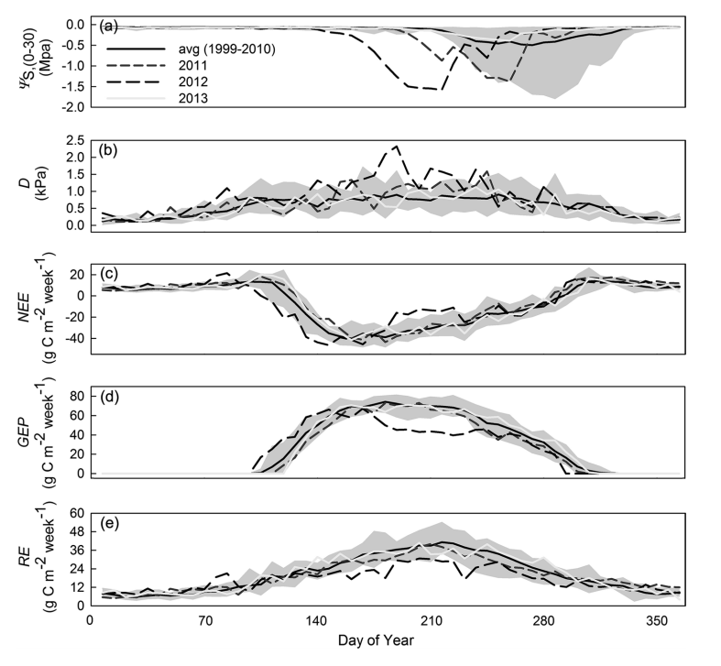
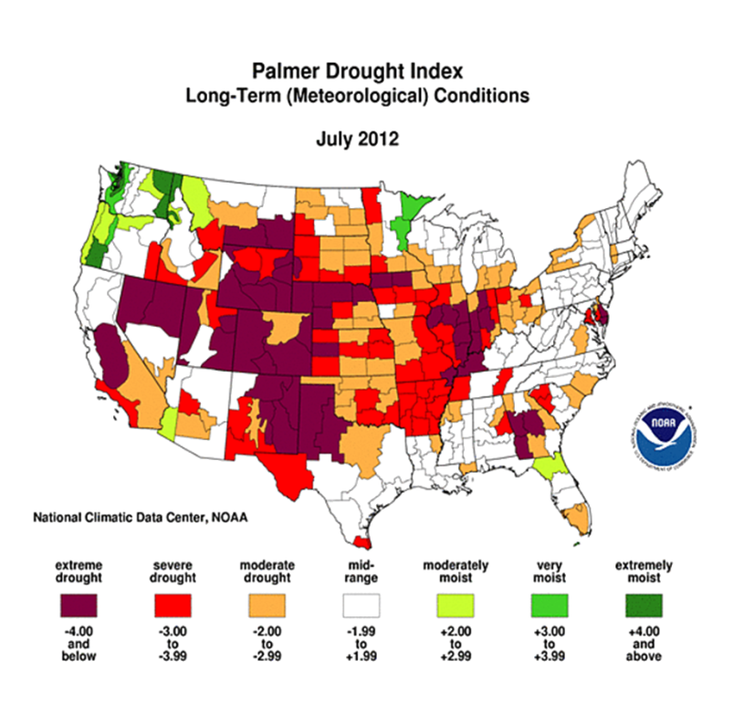
Modeling stomatal conductance during the course of a severe drought event at Morgan Monroe State Forest – a practical exercise
Roman et al. 2015
In Morgan-Monroe State Forest in 2012:
Long-term mean rainfall for June & July: 243 mm
Total Rainfall in June & July of 2012: 23 mm

Slide 23
